Slide 1

The Key to Agent Performance and Reliability
Context Engineering
Presented by Zach Etier & Jeff Knepper
BETTER DATA, BETTER DECISIONS

Slide 2
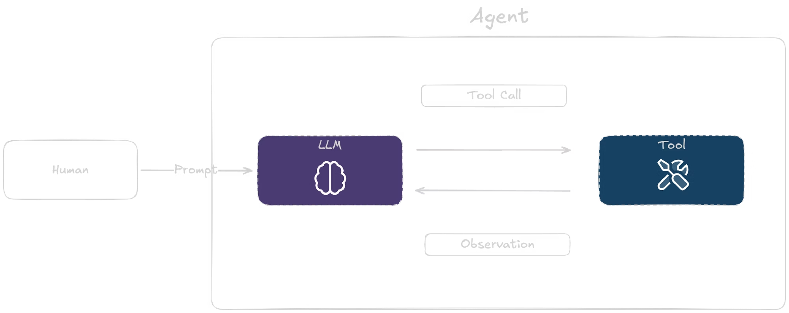
What is an Agent?
An agent is an LLM that can call tools in a loop. The human provides input, the LLM reasons about what to do, calls the appropriate tool, observes the result, and continues this cycle until the task is complete.
BETTER DATA, BETTER DECISIONS

Slide 3
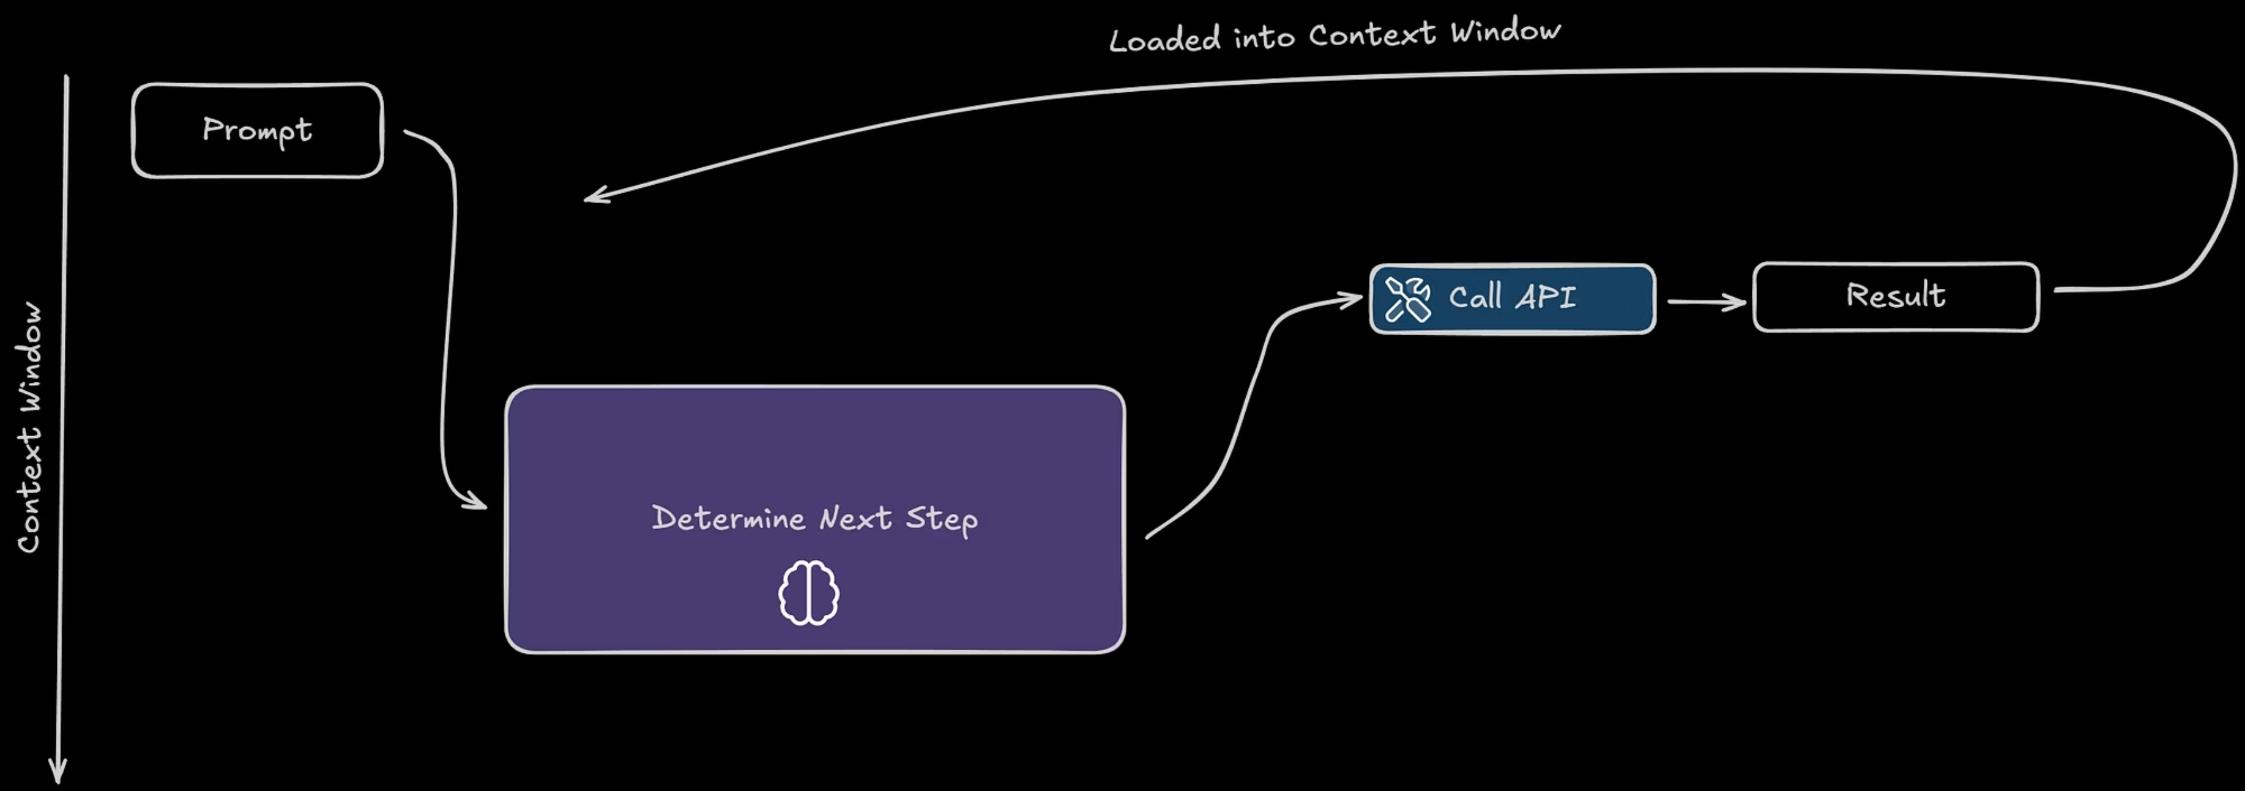
BETTER DATA, BETTER DECISIONS

Slide 4
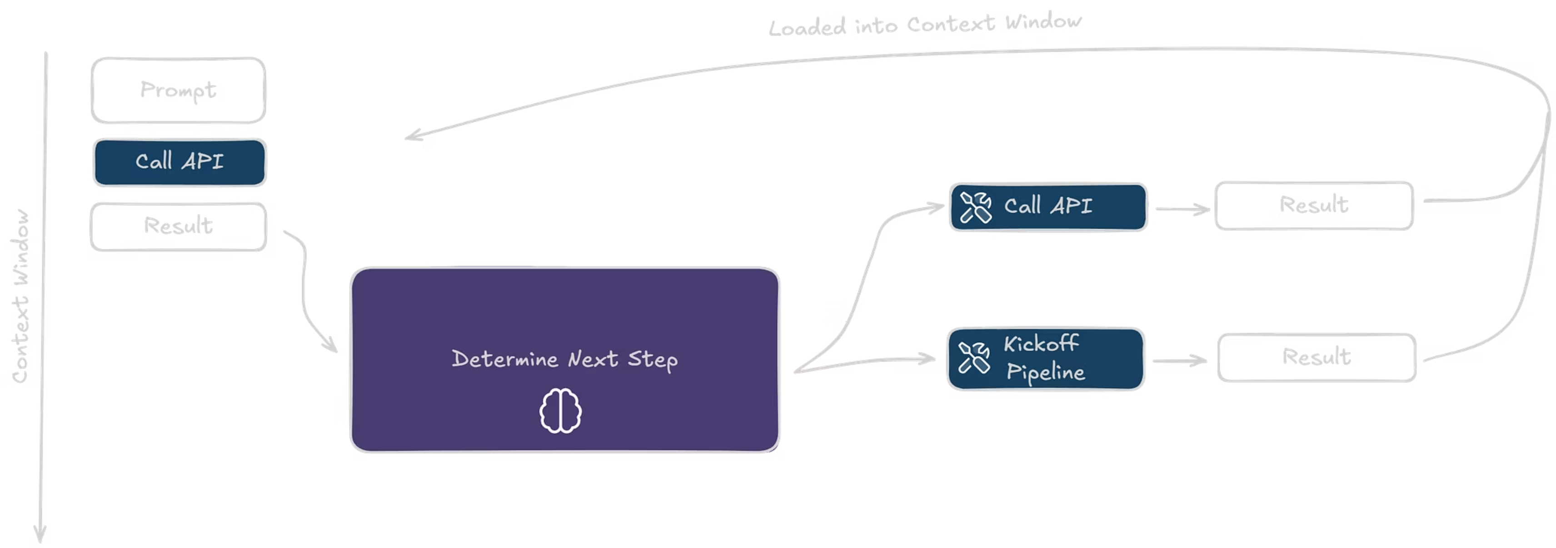
BETTER DATA, BETTER DECISIONS

Slide 5
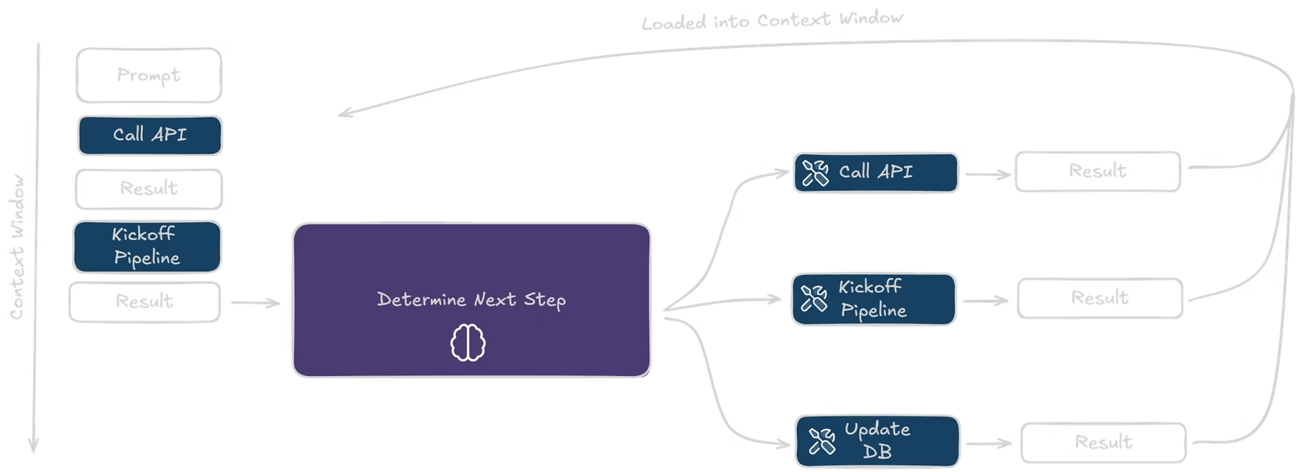
BETTER DATA, BETTER DECISIONS

Slide 6
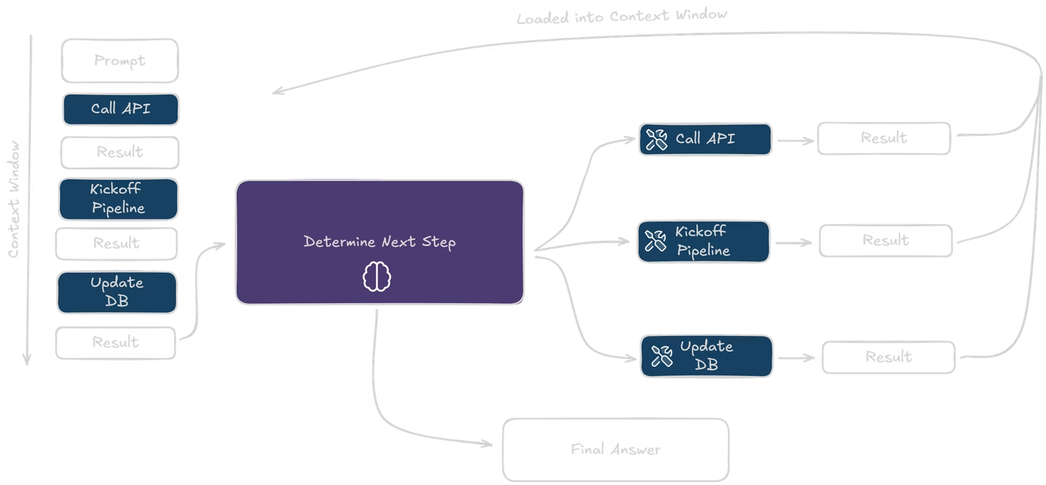

BETTER DATA, BETTER DECISIONS

Slide 7

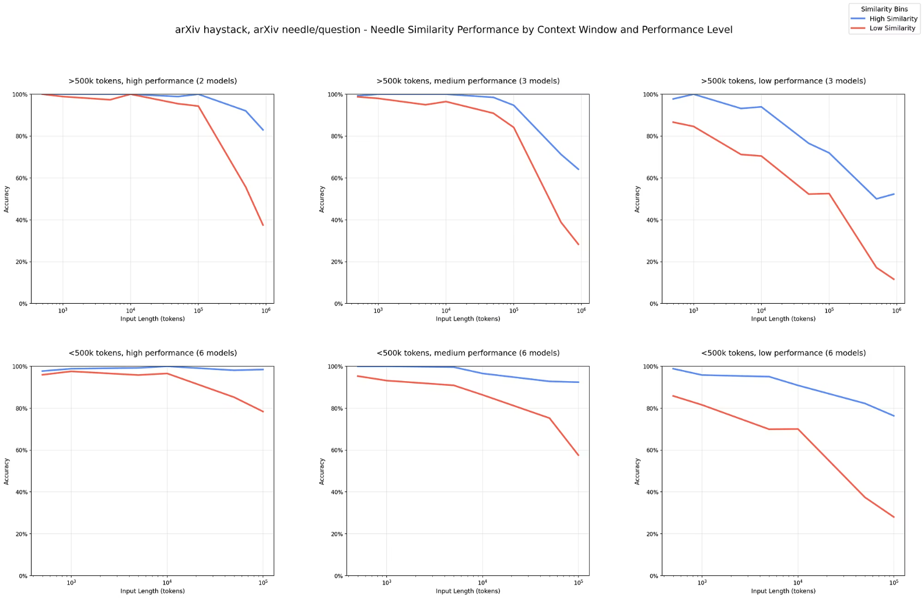
The Context Window Challenge
Keep Context Small:
The model only reasons reliably (Red Line) when input is short. To maintain intelligence, you must aggressively curate and reduce context to stay on the high-performance "left side" of the curve.
Reasoning "Rots" with Volume:
While models can "Ctrl+F" keywords in massive files (Blue Line), their ability to actually *understand* and connect concepts (Red Line) crashes as the window fills.
Signal-to-Noise Ratio:
The drop in performance is caused by "distractors" (irrelevant data) overwhelming the attention mechanism. Adding more data often makes the agent dumber, not smarter.
Source: research.trychroma.com/context-rot
BETTER DATA, BETTER DECISIONS

Slide 8
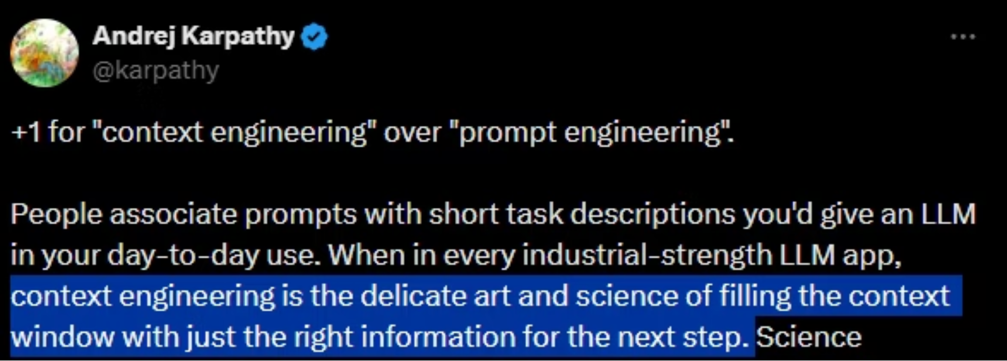
BETTER DATA, BETTER DECISIONS

Slide 9


BETTER DATA, BETTER DECISIONS

Slide 10

Context is an Engineered Product
"Context is the constructed state that grounds the model. It is a curated fusion of facts, live telemetry, active constraints, etc that enables the agent to reason."
Directives & Standard Work
Domain Knowledge
Governance & Safety
The combination of the agent's core behavioral rules and the strict, step-by-step Standard Operating Procedures (SOPs) it must follow.
The specific, filtered slice of technical documentation (manuals, schematics, specs) relevant to the current asset or problem.
Strict negative constraints ensuring the agent adheres to both safety regulations (OSHA) and operational boundaries.
Operational State (Live)
Workflow Context
Tribal Wisdom
The real-time fusion of the immediate conversation history ('What the user just asked') and live machine telemetry ('Current Temp: 90°C').
Knowing exactly where we are in the business process (e.g., 'Step 3 of 5 in Work Order #1234') to guide the next logical step.
Historical solutions, shift notes, and expert examples ('How Bob fixed it last time') used to pattern-match the correct reasoning.
BETTER DATA, BETTER DECISIONS

Slide 11
3 Techniques of Context Engineering
Offload — Move context out of the LLM's context window and store it in the filesystem
Reduce — Decrease the amount of context sent to the LLM
Isolate — Separate context windows for different tasks
BETTER DATA, BETTER DECISIONS

Slide 12

What Is the Harness?
The body for the AI's brain
The model is the operator. The harness is the control system — interlocks, permissions, validation.
Evaluating a Harness
Opinionated
Unopinionated
Prescriptive workflows
Limited flexibility
Harder to customize
Flexible foundation
User-controlled extensions
Adaptable to your needs
What to Look For
Observability
Multi-agent
Prompts & Commands
Monitor and trace agent behavior
Coordinate multiple AI agents
Structured instruction management
Session Management
Tooling
Hooks
Handle state across interactions
Extensible tool integration (MCP, APIs)
Intercept and control agent actions
BETTER DATA, BETTER DECISIONS

Slide 13
Tecnique: Offload
Move context out of the LLM's context window and store it in the filesystem.
Isolate
Reduce
Separate context windows for different tasks
Offload
Decrease the amount of context sent to the LLM
Move Context out of the LLM's context window and store it in the filesystem
BETTER DATA, BETTER DECISIONS

Slide 14
LIVE DEMO
Persist context to filesystem
Offload context from tools to skills stored on filesystem
BETTER DATA, BETTER DECISIONS

Slide 15
Technique: Reduce
Decrease the amount of context sent to the LLM.
Isolate
Reduce
Separate context windows for different tasks
Offload
Decrease the amount of context sent to the LLM
Move Context out of the LLM's context window and store it in the filesystem
BETTER DATA, BETTER DECISIONS

Slide 16
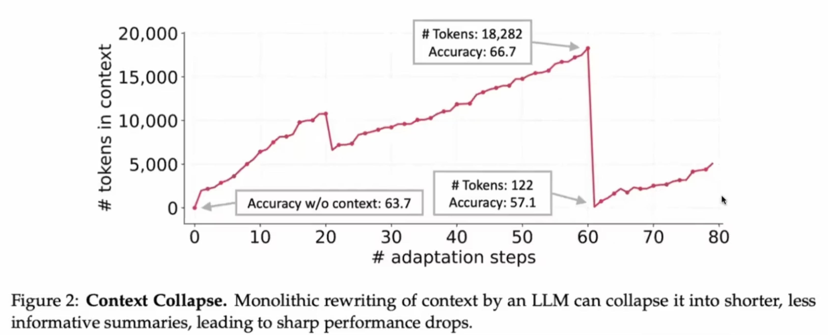
Auto < Intentional Compaction
Source: arXiv:2510.04618
BETTER DATA, BETTER DECISIONS

Slide 17
LIVE DEMO
Compaction / Summarization
BETTER DATA, BETTER DECISIONS

Slide 18
Technique: Isolate
Separate context windows for different tasks.
Isolate
Reduce
Separate context windows for different tasks
Offload
Decrease the amount of context sent to the LLM
Move Context out of the LLM's context window and store it in the filesystem
BETTER DATA, BETTER DECISIONS

Slide 19
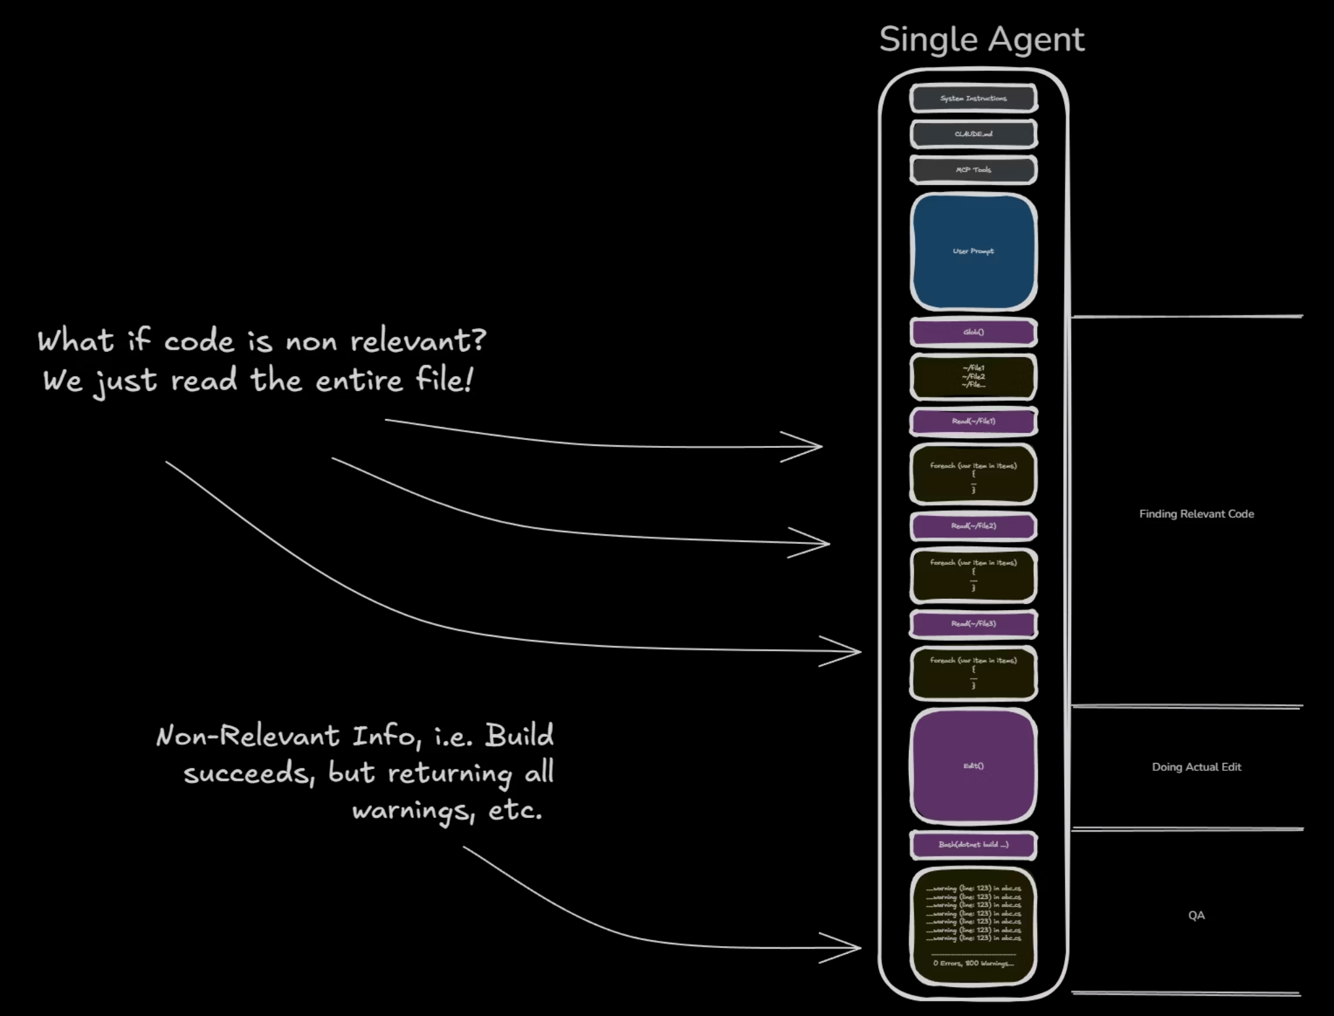

Only Load what Matters
Sometimes we want to isolate context from an agent because its a biproduct of doing the work.
BETTER DATA, BETTER DECISIONS

Slide 20
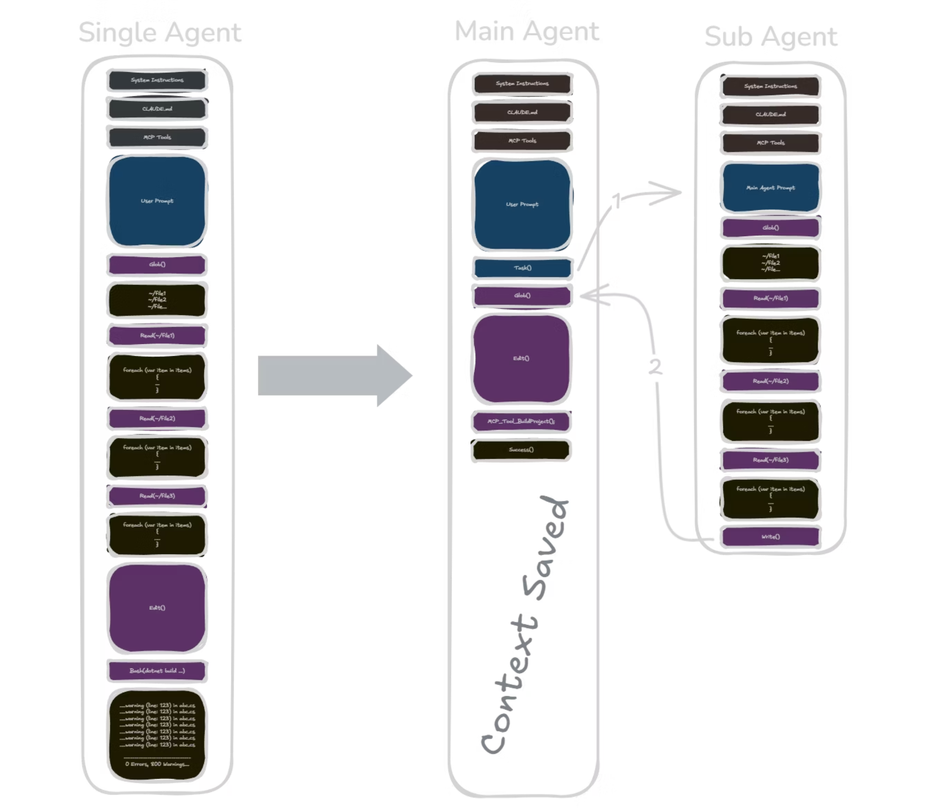

BETTER DATA, BETTER DECISIONS

Slide 21
LIVE DEMO
Subagents / Teams
BETTER DATA, BETTER DECISIONS

Slide 22
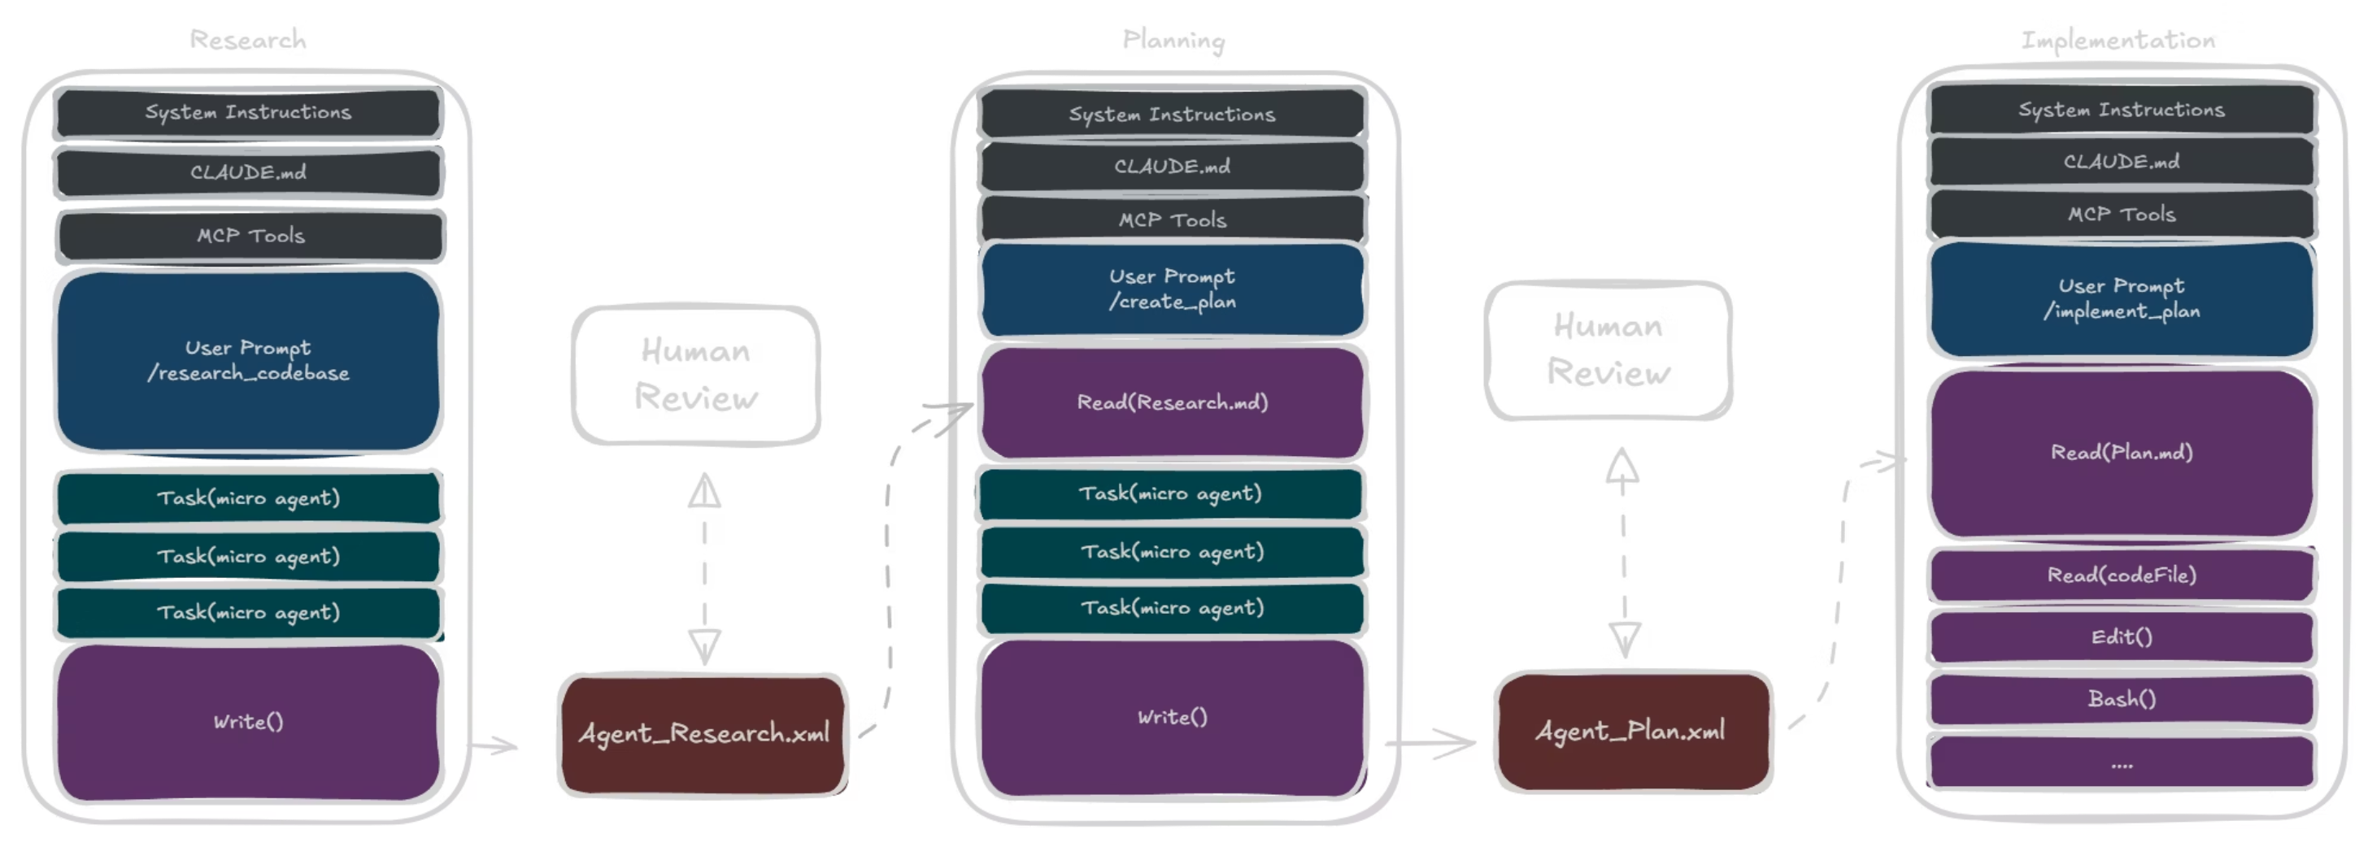

Putting It All Together: Research → Plan → Implement
A structured workflow for reliable AI agents
This workflow pattern is considered a staple for building reliable agentic systems among many agentic engineers.
BETTER DATA, BETTER DECISIONS

Slide 23
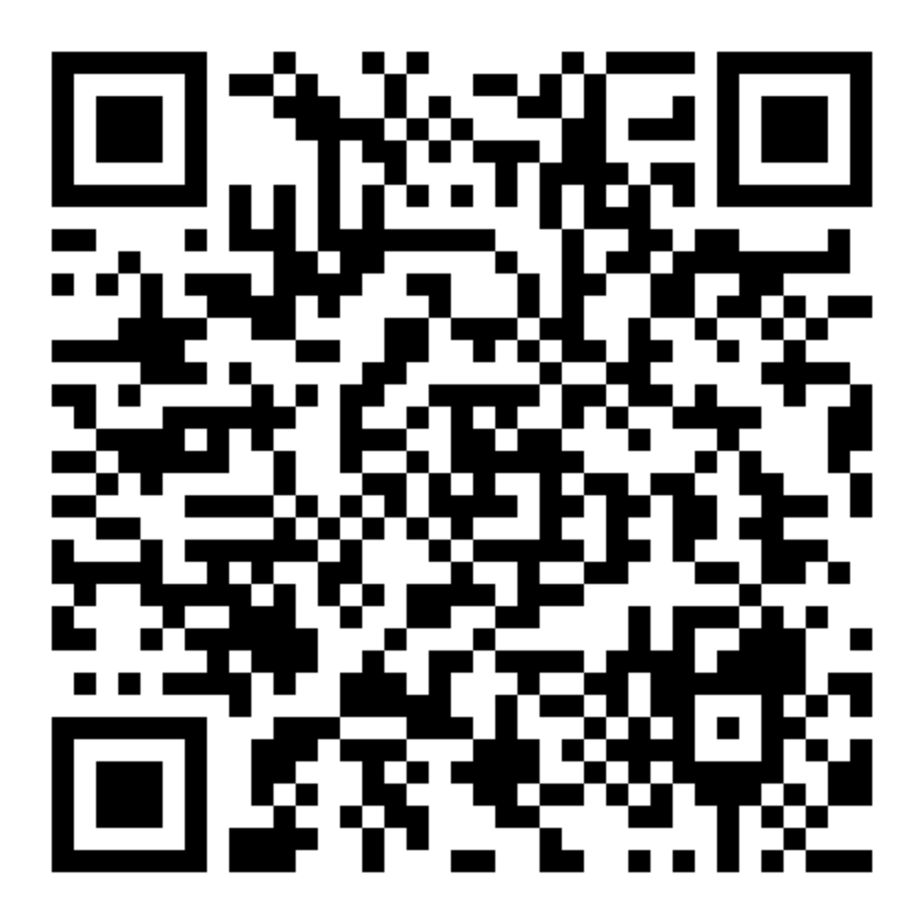
Let's Get Started
We don't have enough time to cover everything in depth today.
We'll walk through the workshop together.
All resources, code, and materials are available after the session.
Scan the QR code to access everything.
BETTER DATA, BETTER DECISIONS

